Slide 1
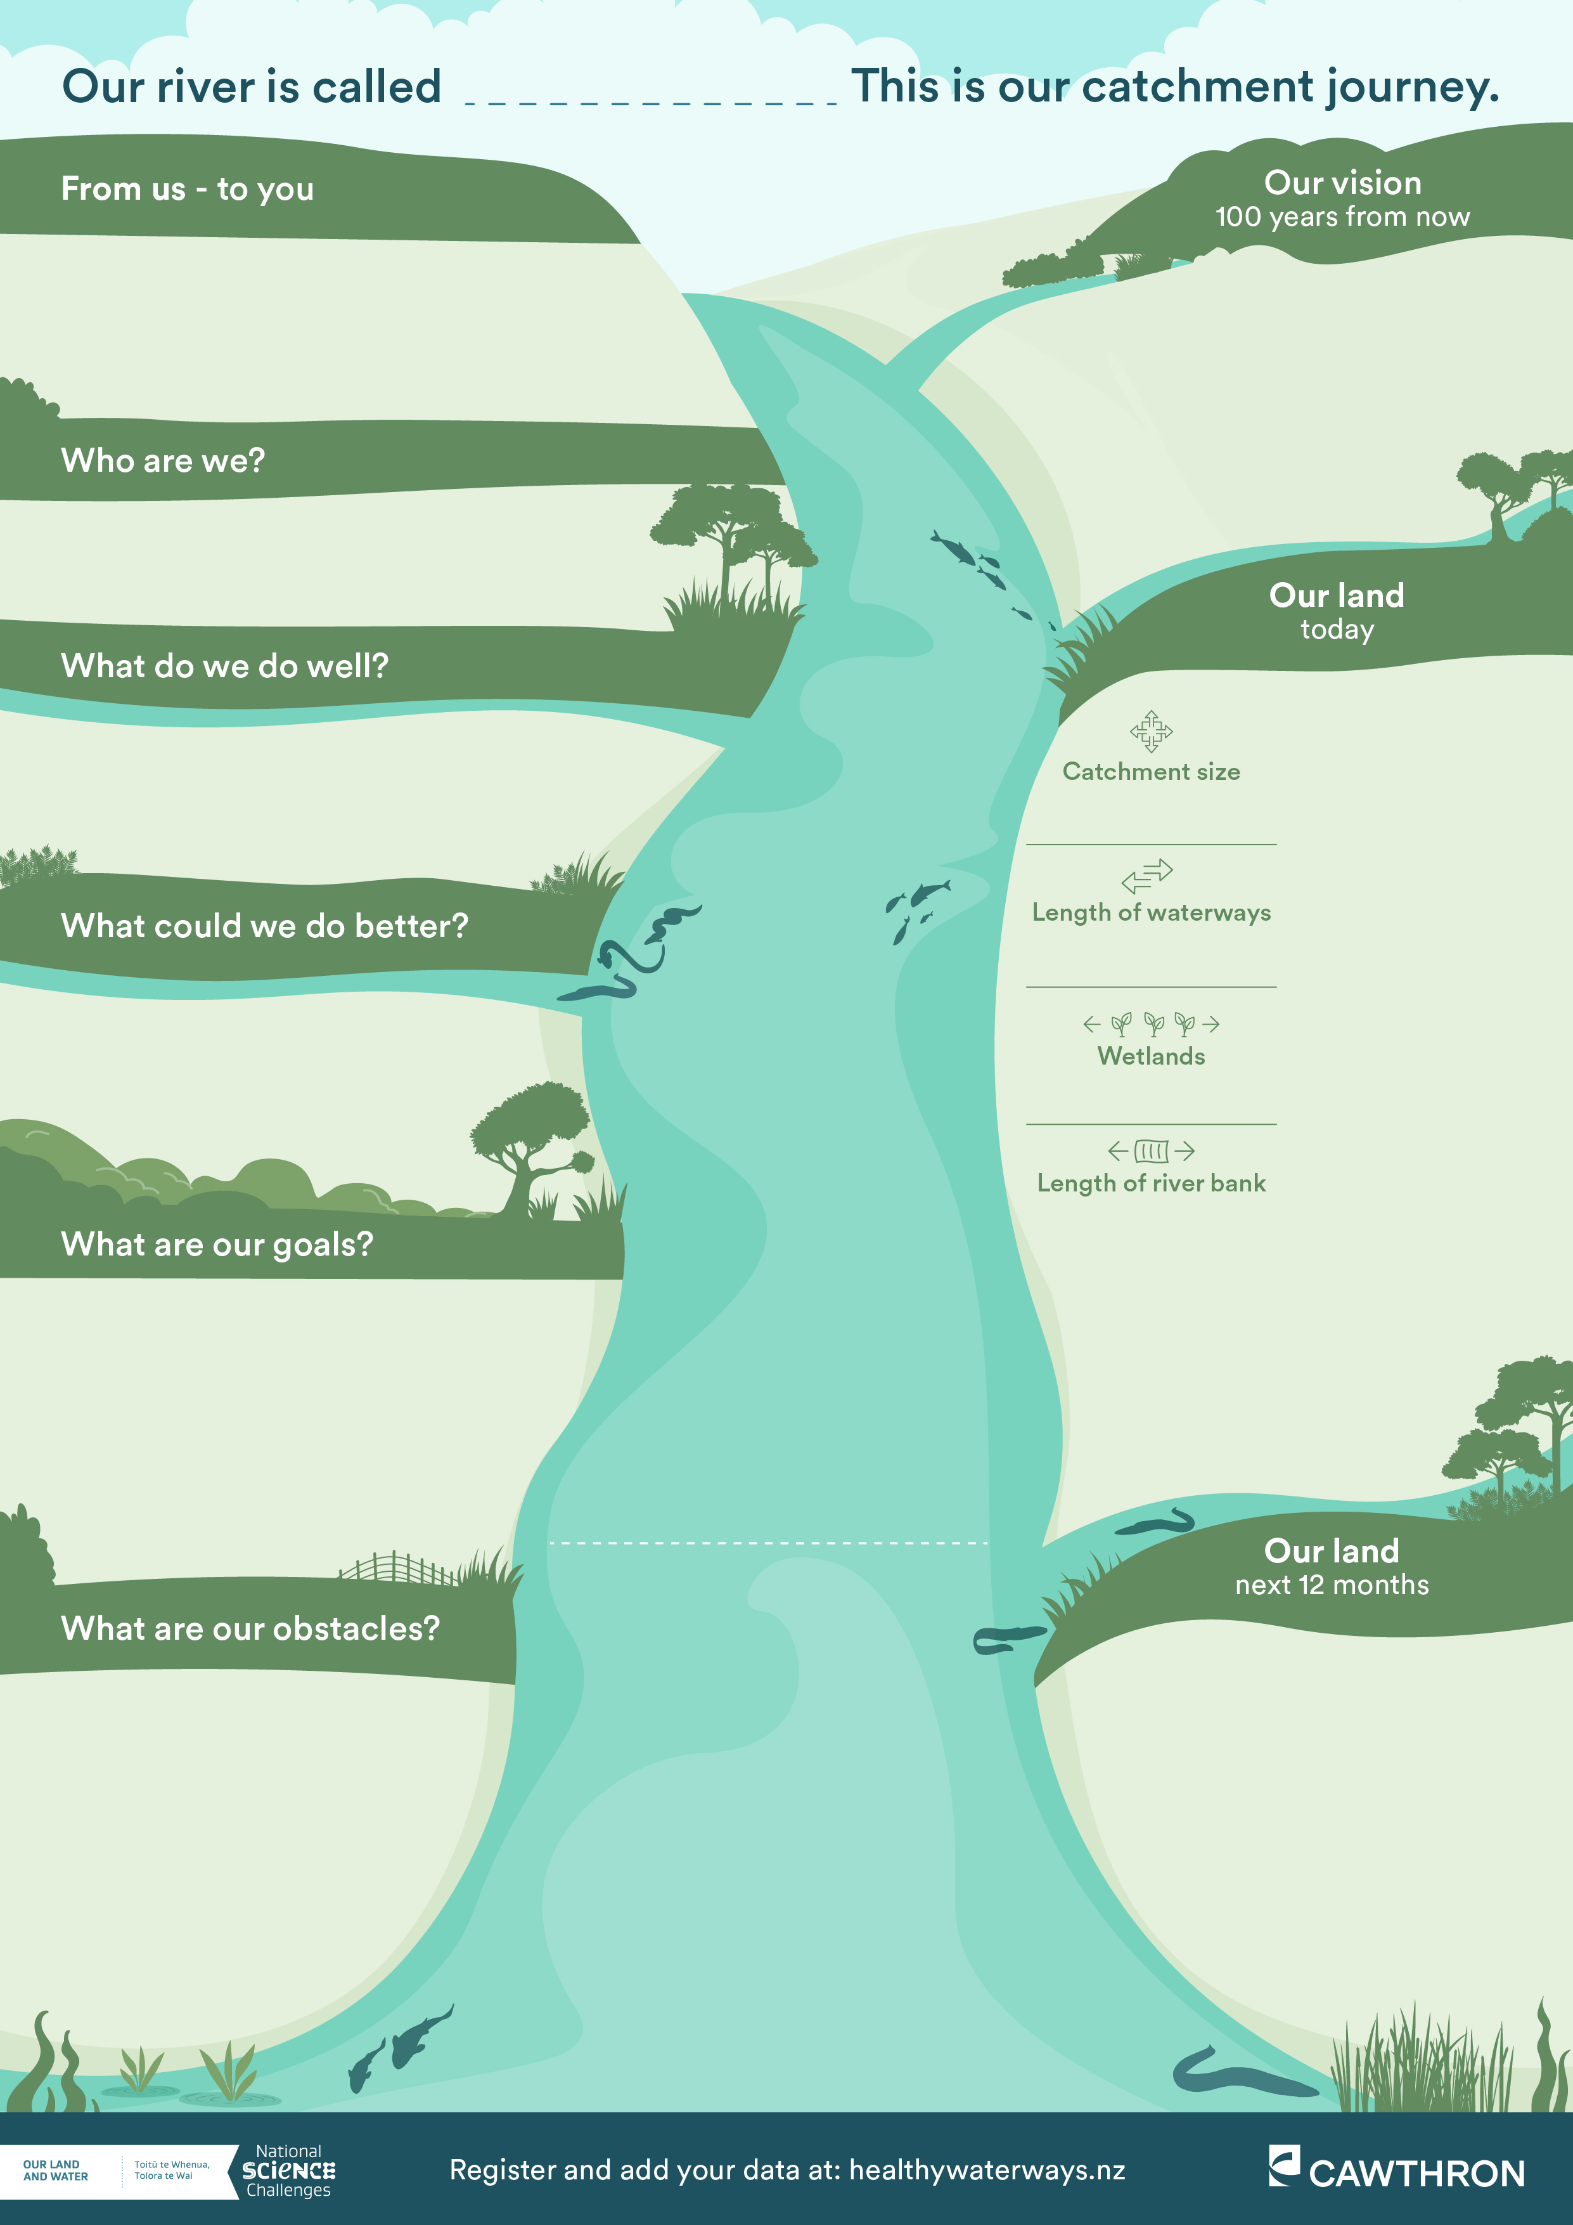

(Write here…)
(Write here…)
(Write here…)
(Write here…)
(Write here…)
(Write here…)
(Write here…)
Your map here
(Write here…)
(Write here…)
(Write here…)
Access your info:
healthywaterways.nz
lawa.org.nz/explore-data/river-quality
(Write here…)
(Write here…)
Group photo

Slide 2
